Slide 1
Bivariate Regression
SSI II
February 12, 2019

Slide 2
Previously
Hypothesis testing
Confidence intervals
Uncertainty and significance
Pearson’s r
Covariance

Slide 3
Essential Questions
What does regression tell us about our data and our theories?
How does regression work?
How do we interpret regression results?

Slide 4
Type I and Type II Errors

Slide 5
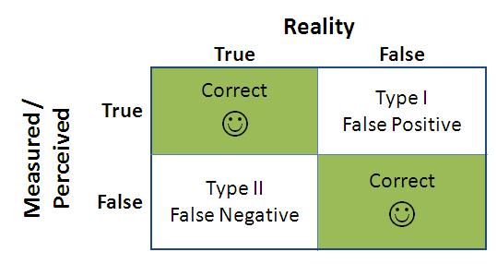
An aside: Type I and Type II Errors

Slide 6
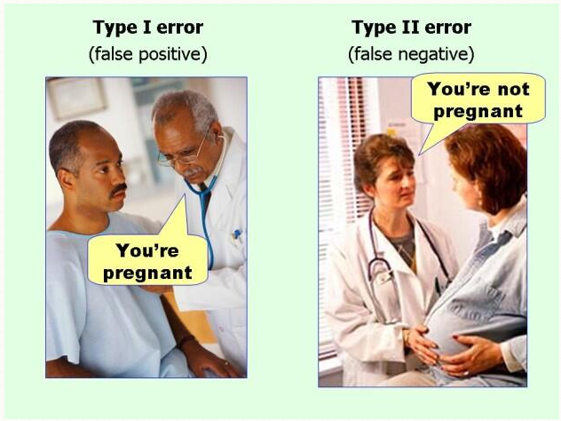
Type I and Type II Errors
Notes:
Image source: Ellis, P.D. (2010), “Effect Size FAQs,” website http://www.effectsizefaq.com

Slide 7
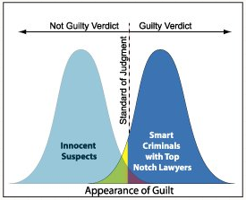
Type I and Type II Errors
Notes:
Null hypothesis: innocent
Type 1 Error: False positive – when you reject the null and it is actually true
In this case, a Type 1 error is finding a guilty verdict when they are actually innocent
Type 2 Error: False negative – when you accept the null hypothesis and it is actually false
In this case, a Type 2 error is finding a not guilty verdict when they are actually guilty

Slide 8
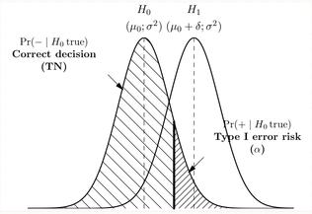
Type I and Type II Errors

Slide 9
One way to remember…
The number of times you say “not”
Type 1: I was not correct in rejecting the null
Type 2: I was not correct in not rejecting the null

Slide 10
Another way to remember…
When the village boy cried wolf:
There not being a wolf is the null hypothesis
The villagers first made a type I error in believing him
The villagers second made a type II error in not believing him

Slide 11
Others…
“Once bitten, twice shy”
Innocent until proven guilty
So not proving an innocent man guilty is of primary concern, whereas letting a guilty man go free is of secondary concern
“Innocent” starts with an “I”
The “P” in false positive has one vertical line; the “N” in false negative has two vertical lines
“RAAR” like a lion – first Reject when we should Accept (type I), second Accept when we should Reject (type II)
“It’s Type I not II when the null is true”

Slide 12
Type I and Type II Errors
Lessening the chance of one type will increase the chance of the other
The chance of each depends on the significance level you choose
When might we be more willing to accept Type I errors? Less willing?

Slide 13
Regression

Slide 14
Algebra Review: Equation of a Line
Slope – Amount of increase in Y associated with a 1 unit increase in X
y
x

Slide 15
Algebra Review: Equation of a Line
Slope – Amount of increase in Y associated with a 1 unit increase in X
y
(x₂,y₂)
Rise
(x₁,y₁)
Run
x

Slide 16
Algebra Review: Equation of a Line
Intercept – the point where the line intersects the Y axis (value of Y when X is 0)
Intercept = b
y
(0,b) = Intercept
x

Slide 17
Algebra Review: Equation of a Line
y
(x₂,y₂)
Rise
(x₁,y₁)
Run
(0,b) = Intercept

Slide 18
Hypothetical Example
hours | test1
0 | 55
1 | 61
2 | 67
3 | 73
4 | 79
5 | 85
6 | 91
7 | 97

Slide 19
Hypothetical Example
hours | test2
0 | 70
1 | 72
2 | 74
3 | 76
4 | 78
5 | 80
6 | 82
7 | 84
Notes:
test1 = 6*hours + 55
test2 = 2*hours + 70
Slope = 74-72/2-1 = 2 y=70+2x

Slide 20
Typical data: Noisy relationships

Slide 21
Typical data: Noisy relationships

Slide 22
Population Regression Model
A statistical model of the process that generates the data, consisting of a linear equation plus random error (noise)
Deterministic
(non-random)
Stochastic error term
(random)

Slide 23
Population Regression Model
Deterministic
(non-random)
Stochastic error term
(random)

Slide 24
Population Regression Model
Deterministic
(non-random)

Slide 25
Population Regression Model
Deterministic
(non-random)
Stochastic error term
(random)

Slide 26
Population Regression Model
A statistical model of the process that generates the data, consisting of a linear equation plus random error (noise)
The population regression model provides a precise way of describing the relationship between two variables
Deterministic
(non-random)
Stochastic error term
(random)

Slide 27
Estimation and Inference
The parameters (slope, intercept) of the population regression model are unknown and must be estimated from sample data
Incumbent Party Vote Share
GDP and Presidential Vote
% GDP Growth
Notes:
Here, correlation, r=0.72 – fairly high

Slide 28
Objectives of regression analysis
Apply same basic principles of statistical inference to the regression model
We use sample data to:
Estimate population regression parameters
Measure uncertainty about parameters
Test hypotheses and draw inferences about the unknown population regression parameters

Slide 29
Estimation: Fitting a line
Incumbent Party Vote Share
GDP and Presidential Vote
% GDP Growth

Slide 30
Sample regression model
The sample regression model is the regression model (linear equation plus noise) that describes the sample data
We use “hats” above the Greek letters to denote the parameter estimates
We also indicate the sample error term with a “hat”

Slide 31
Estimation: Fitting a line
Incumbent Party Vote Share
GDP and Presidential Vote
% GDP Growth
Notes:
This looks reasonable

Slide 32
Estimation: Fitting a line
Incumbent Party Vote Share
GDP and Presidential Vote
% GDP Growth
Notes:
This looks reasonable, too! How do we know which line we should use?

Slide 33
Estimation: Fitting a line
Incumbent Party Vote Share
GDP and Presidential Vote
% GDP Growth
Notes:
This line LOOKS worse than the others. But we need an objective way to quantify the degree of fit

Slide 34
How do we know which line fits best?
Incumbent Party Vote Share
GDP and Presidential Vote
% GDP Growth
Notes:
We need an quantitative measure of “fit”
To measure fit, we need to define some other concepts.

Slide 35
Predicted values
GDP and Presidential Vote
65
Incumbent Party Vote Share
60
Predicted value
55
50
45
1
2
3
4
5
% GDP Growth
For any value of X, the predicted value is the value of Y on the sample regression line (estimated line)
Notes:
Every point along the line is a predicted value

Slide 36
Residuals
Incumbent Party Vote Share
GDP and Presidential Vote
65
60
Predicted value
55
Residual
Actual
value
50
45
1
2
3
4
5
% GDP Growth
For any observation, the residual is the difference between the actual value and the predicted value of Y

Slide 37
Residual
Actual
value
Incumbent Party Vote Share
65
GDP and Presidential Vote
Residual
60
Predicted value
55
50
45
1
2
3
4
5
% GDP Growth
For any observation, the residual is the difference between the actual value and the predicted value of Y

Slide 38
Residual
Incumbent Party Vote Share
GDP and Presidential Vote
65
60
Predicted value
55
Residual
Actual
value
50
45
1
2
3
4
5
% GDP Growth
For any observation, the residual is the difference between the actual value and the predicted value of Y

Slide 39
Sum of squared residuals
GDP and Presidential Vote
Line 1
65
60
Line 2
55
pres inc party vote
50
Line 3
45
1
2
3
4
5
% GDP Growth

Slide 40
Ordinary least squares
Ordinary least squares (OLS) computes the best fitting line by choosing to minimize the sum of squared residuals
65
60
55
pres inc vote
50
45
1
2
rdi
3
4
5

Slide 41
Population vs sample regression
Notes:
Emphasize: for the same regression model, every realization of RANDOM ERRORS (randomness) will mean that the data do not perfectly line up with the original. We ESTIMATE the population model using the sample data, but will never recover the actual parameters. Just like with other statistics, such as the sample mean

Slide 42
Population vs sample regression

Slide 43
Population vs sample regression

Slide 44
Population vs sample regression

Slide 45
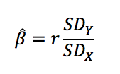
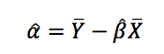
The OLS Regression Line
The covariance of x and y and variance of x
The means, standard deviations, and correlation

Slide 46
Regression and Statistical Inference
Just as with other kinds of statistics, our sample estimates will partly depend on random noise

Slide 47
Admission Rate and Fed Loans

Slide 48
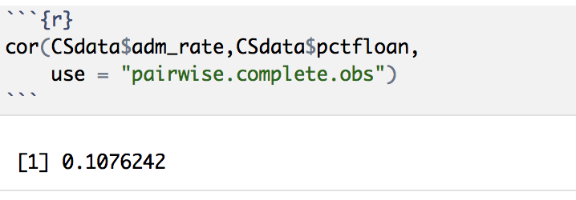
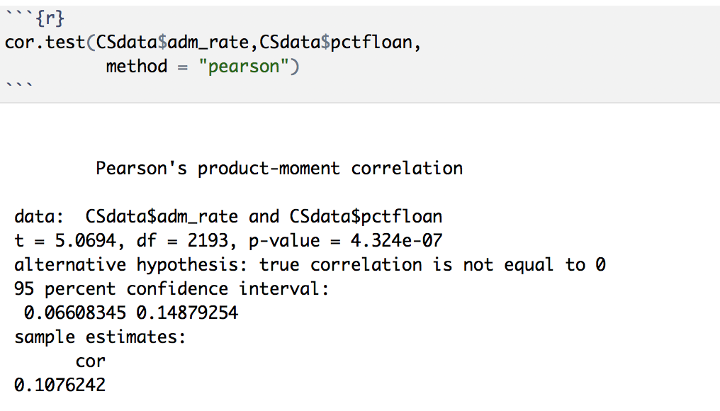
Admission Rate and Fed Loans

Slide 49
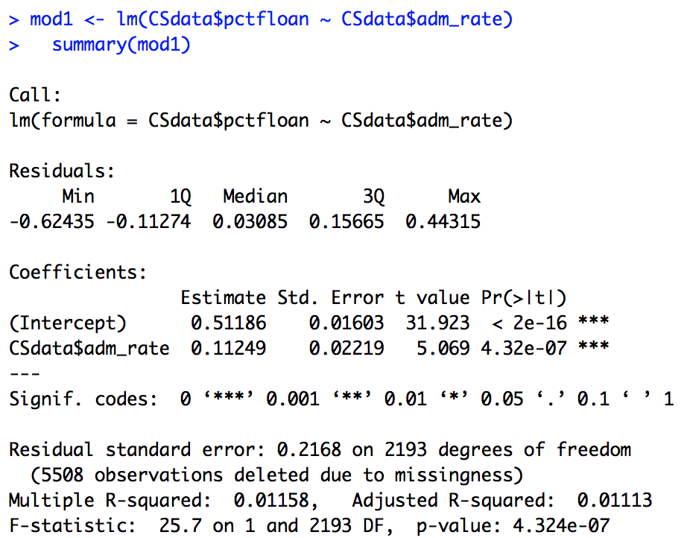
Interpreting Regression Results
Dependent Variable
Independent Variable

Slide 50
The Regression Model
Independent Variable
The school’s admission rate, measured as a percentage in decimal form (0-1)
Dependent Variable
The percentage of students on federal loans, measured as a percentage in decimal form (0-1)

Slide 51
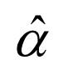
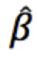
Interpreting Regression Results
p-value for α-hat
p-value for β-hat

Slide 52
Interpreting Regression Results
=.51186
When X is equal to 0, Y will, on average, have a value of
On average, when a school has an admissions rate of 0, 51.186% of students will have federal loans
=.11249
When X increases by 1, Y will, on average, increase/decrease by
When a school’s admission rate increases to 100%, students will, on average, have 11% more federal loans
When a school’s admission rate increases by 1%, students will, on average, have .11% more federal loans

Slide 53
Scatterpot w/ Regression Line

Slide 54
Interpreting Regression Results
We can be 99.999% confident that the relationship between admission rates and federal loan rates is a positive one (p<0.000)
We can be 99.999% confident that, on average, when schools have 0% admission rates, they will have a positive federal loan rate (p <0.000)
We don’t use this that often, at least in this way
In this case, it’s meaningless

Slide 55
Interpreting Regression Results
95% Confidence Interval for α
α-hat ± 2(Se_{α-hat})
.51186 ± 2(.01603)
We are 95% confident that when a school’s admissions rate is 0%, the average percentage of students on federal loans will be between 47.98% and 54.39%
95% Confidence Interval for β
β-hat ± 2(Se_{β-hat})
.11429 ± 2(.02219)
We are 95% confident that when a school’s admissions rate increases by 1%, the average percentage of students on federal loans will increase between .0699% and .1587%

Slide 57
Another way to write these results…
FedLoanRate_{i}=.51186+.11249AdmissionsRate_{i}

Slide 58
Essential Questions
What does regression tell us about our data and our theories?
How does regression work?
How do we interpret the results?

Slide 59
Next Time…
More Regression!
Especially, Goodness-of-fit

